Slide 1


Efficient Core Maintenance in Large Bipartite Graphs
Wensheng Luo¹, Qiaoyuan Yang¹, Yixiang Fang¹, Xu Zhou²
¹The Chinese University of Hong Kong, Shenzhen
²Hunan University

Slide 2

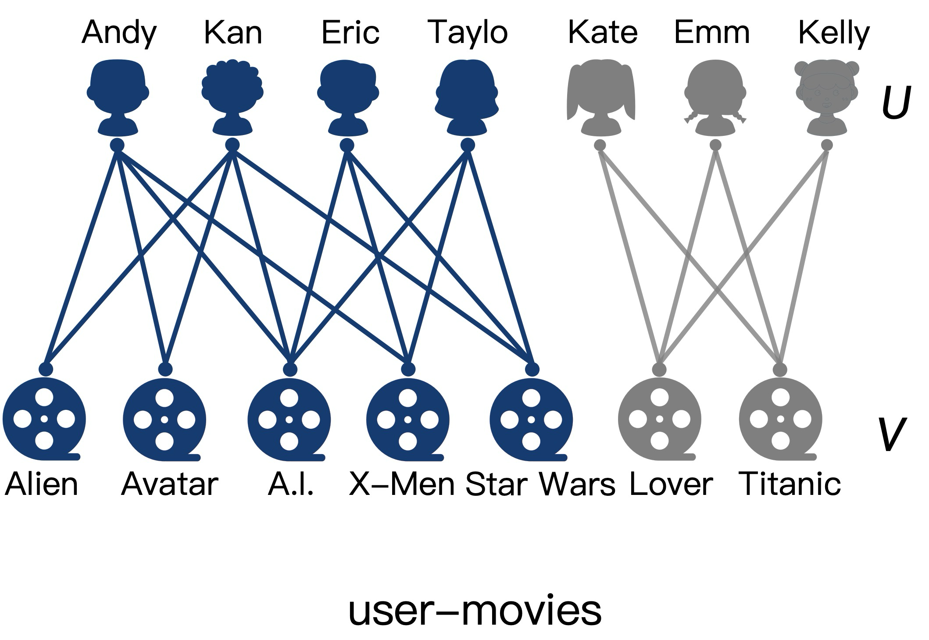
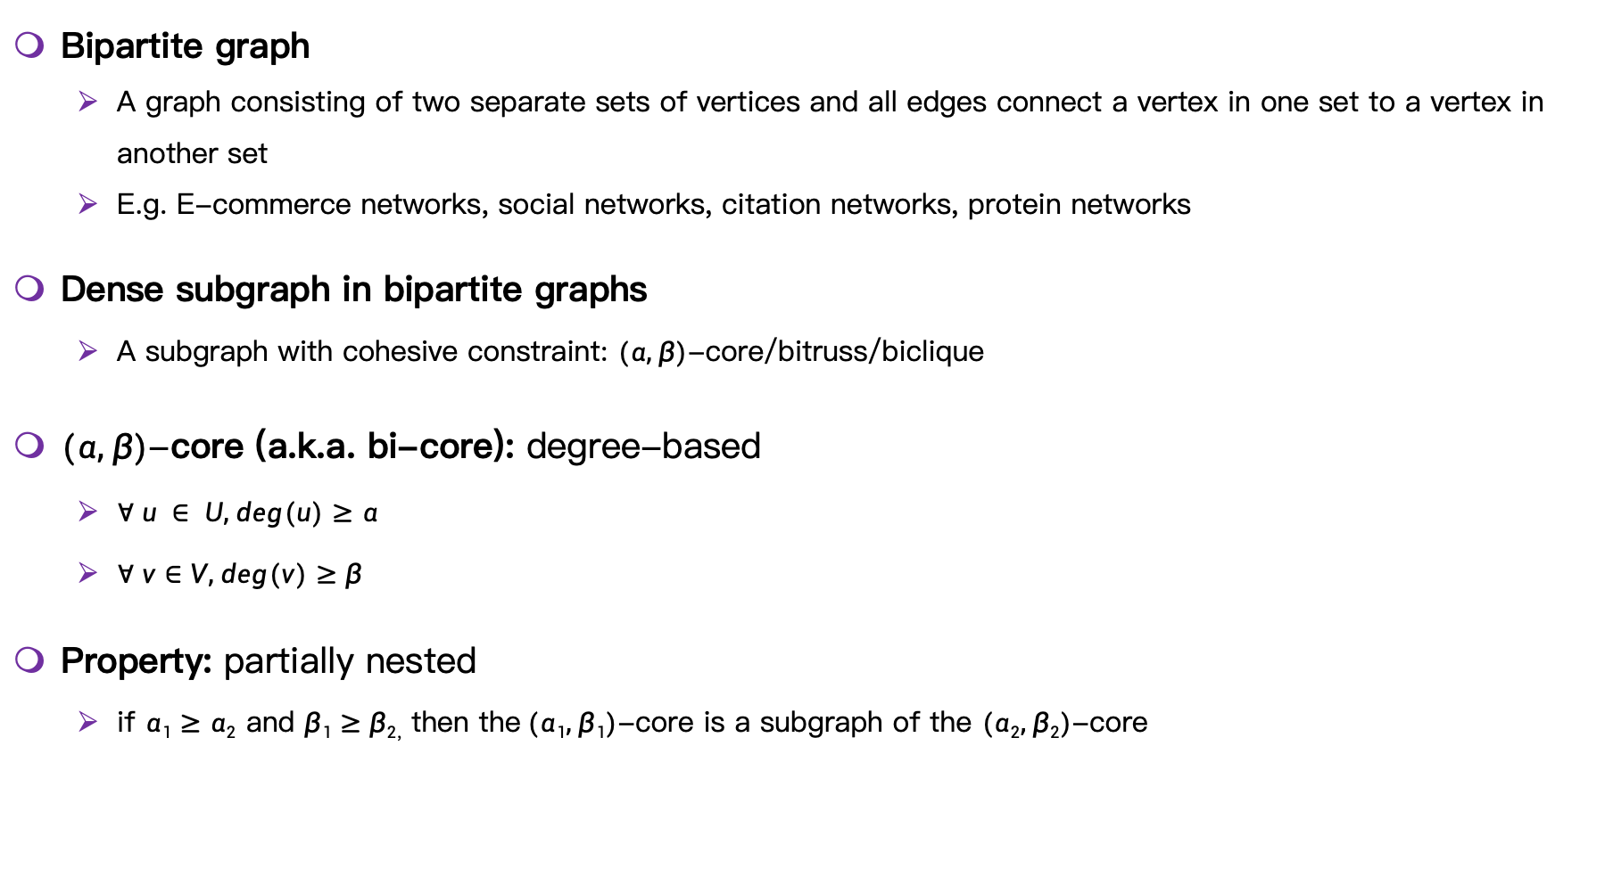
Bipartite graph
Bipartite graph
A graph consisting of two separate sets of vertices and all edges connect a vertex in one set to a vertex in another set
E.g. E-commerce networks, social networks, citation networks, protein networks
Dense subgraph in bipartite graphs
A subgraph with cohesive constraint: $(α, β)$-core/bitruss/biclique
$(α, β)$-core (a.k.a. bi-core): degree-based
$∀ u ∈ U, deg(u)≥α$
$∀ v∈V, deg(v)≥β$
Property: partially nested
if $α1≥α2$ and $β1≥β2$, then the$(α1, β1)$-core is a subgraph of the $(α2, β2)$-core
(3, 2)-core

Slide 3
Applications
Fault-tolerant group recommendation [1]
Speeds up the recommendation process compared to traditional methods, without decreasing the accuracy
Useful in scenarios like Amazon, Yelp, ...
A building block for solving other problems in bipartite graphs
Biclique [2]
Biplex [3]
Bipartite hierarchy [4]
...
Bipartite graphs are usually dynamic
User-movie networks, financial systems, social networks
[1] Danhao Ding, Hui Li, Zhipeng Huang, and Nikos Mamoulis. 2017. Efficient fault-tolerant group recommendation using alpha-beta-core. In Proceedings of the 2017 ACM on CIKM 2047–2050.
[2] Bingqing Lyu, Lu Qin, Xuemin Lin, Ying Zhang, Zhengping Qian, and Jingren Zhou. 2020. Maximum biclique search at billion scale. VLDB 13, 9 (2020), 1359–1372.
[3] Wensheng Luo, Kenli Li, Xu Zhou, Yunjun Gao, and Keqin Li. 2022. Maximum Biplex Search over Bipartite Graphs. In 2022 IEEE 38th ICDE. IEEE, 898–910.
[4] Kai Wang, Wenjie Zhang, Xuemin Lin, Ying Zhang, and Shunyang Li. 2022. Discovering hierarchy of bipartite graphs with cohesive subgraphs. In 2022 IEEE 38th ICDE. IEEE, 2291–2305.

Slide 4
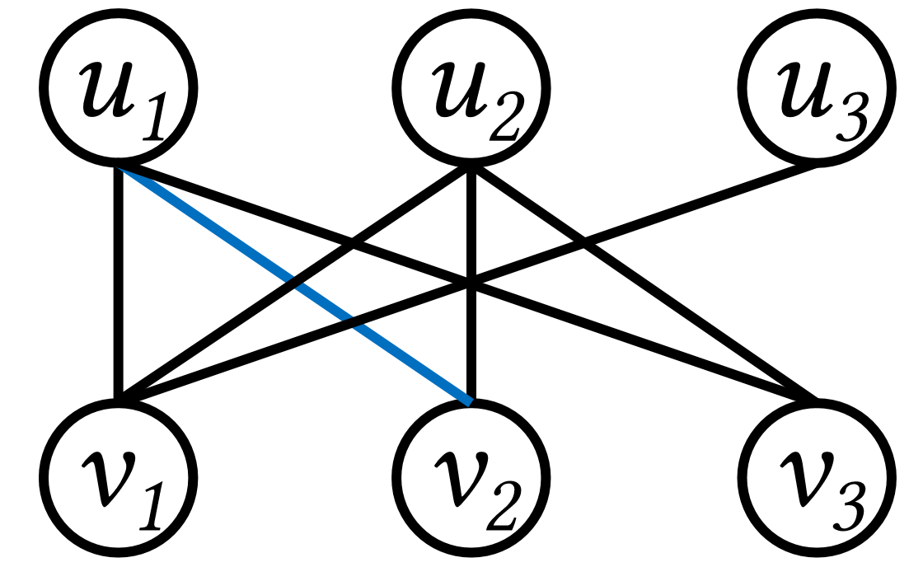
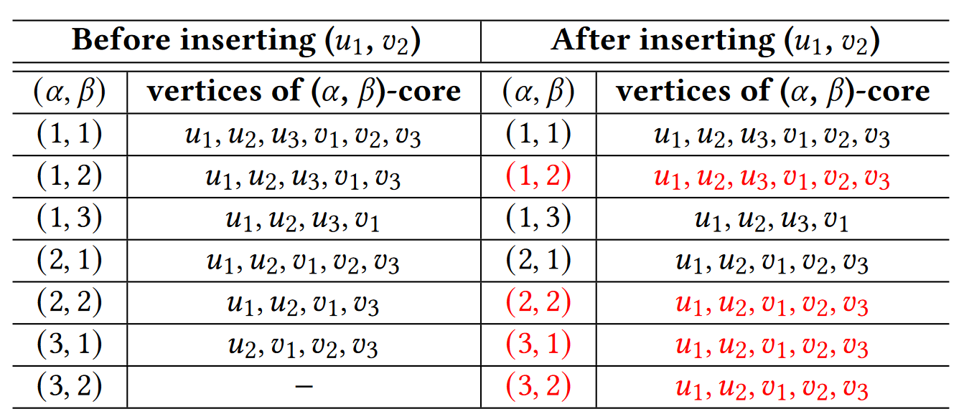
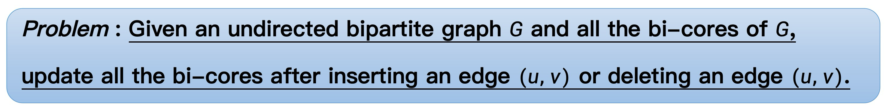
Challenges and problem
Real-world graphs are often huge which leads to high time costs
Twitter has a total of 1.3 billion accounts, so users and tweets constitute a huge network
Real-world graphs are highly dynamic
Twitter has an average of 500 million tweets posted every day
The insertion or deletion of an edge may lead to significant changes in bi-cores

Slide 5
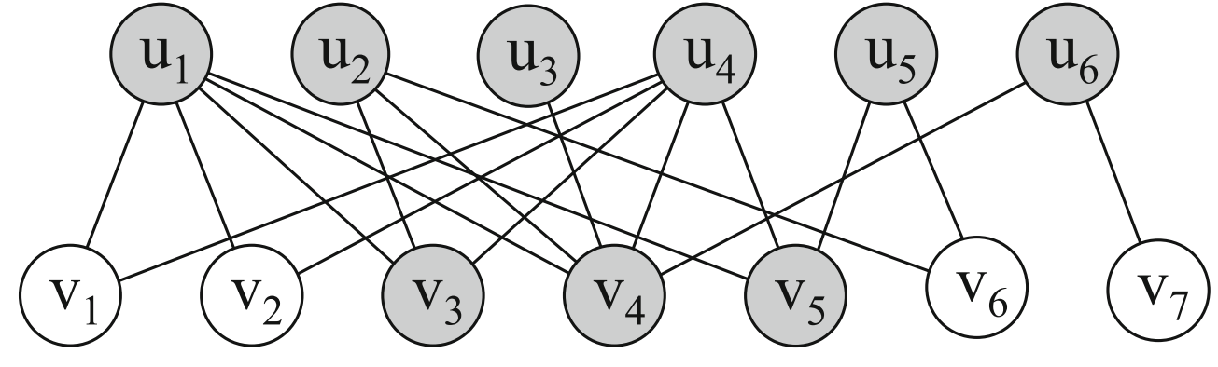
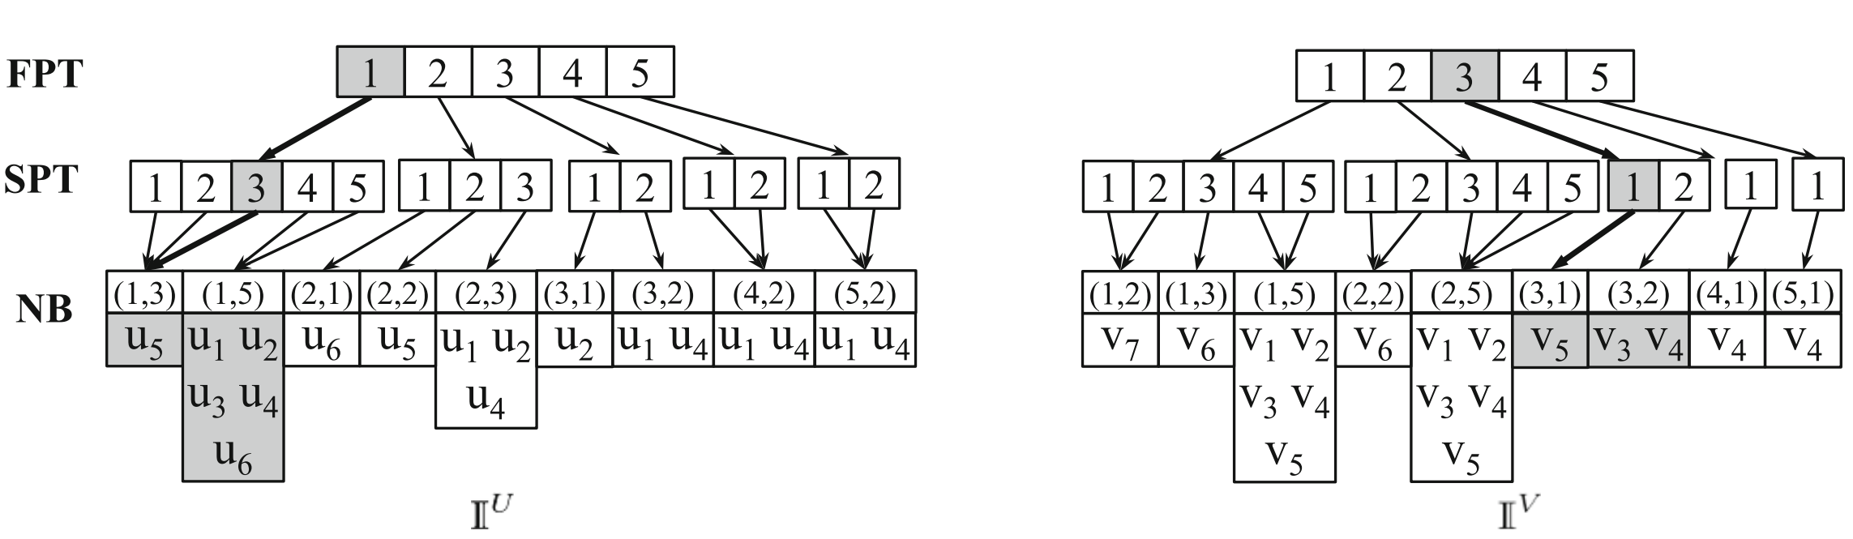
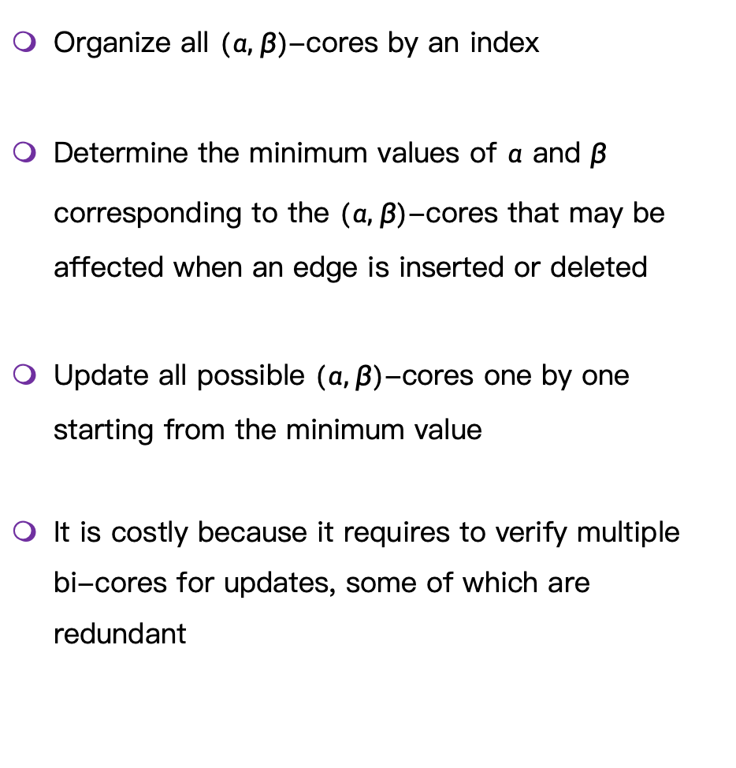
Existing approach
Organize all $(α, β)$-cores by an index
Determine the minimum values of $α$ and $β$ corresponding to the $(α, β)$-cores that may be affected when an edge is inserted or deleted
Update all possible $(α, β)$-cores one by one starting from the minimum value
It is costly because it requires to verify multiple bi-cores for updates, some of which are redundant
[1] Boge Liu, Long Yuan, Xuemin Lin, Lu Qin, Wenjie Zhang, Jingren Zhou: Efficient (α, β)-core computation in bipartite graphs. VLDB J. 29(5): 1075-1099 (2020)

Slide 6
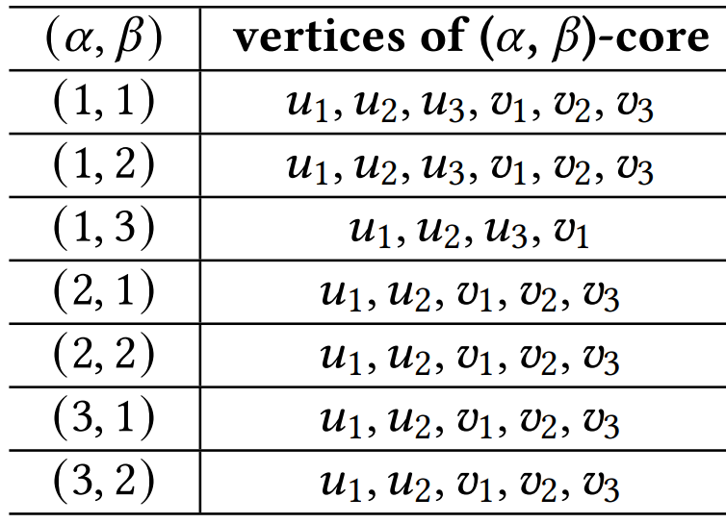
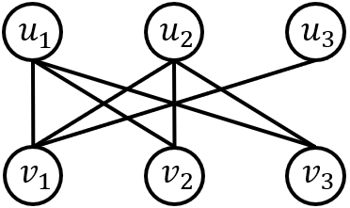
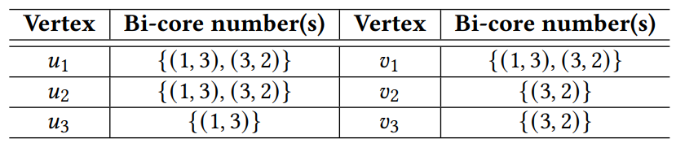
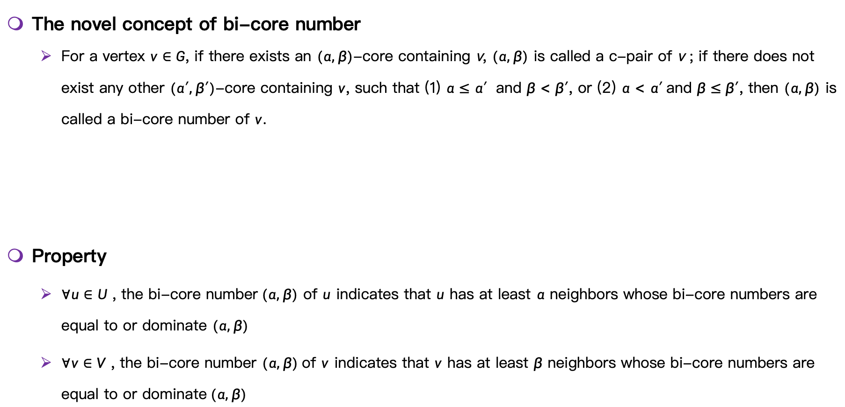
Our approach
The novel concept of bi-core number
For a vertex $v∈G$, if there exists an $(α, β)$-core containing v, $(α, β)$ is called a c-pair of v ; if there does not exist any other $(α′, β′)$-core containing $v$, such that (1) $α≤α′$ and $β<β′$, or (2) $α<α′$and $β≤β′$, then $(α, β)$ is called a bi-core number of $v$.
Property
$∀u∈U$ , the bi-core number$(α, β)$ of $u$ indicates that $u$ has at least $α$ neighbors whose bi-core numbers are equal to or dominate $(α, β)$
$∀v∈V$ , the bi-core number $(α, β)$of $v$ indicates that $v$ has at least $β$ neighbors whose bi-core numbers are equal to or dominate$(α, β)$

Slide 7
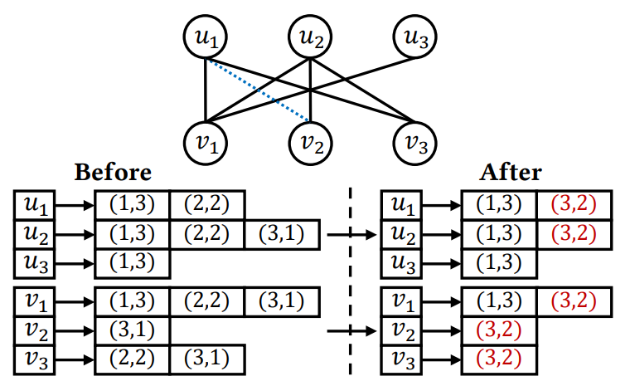
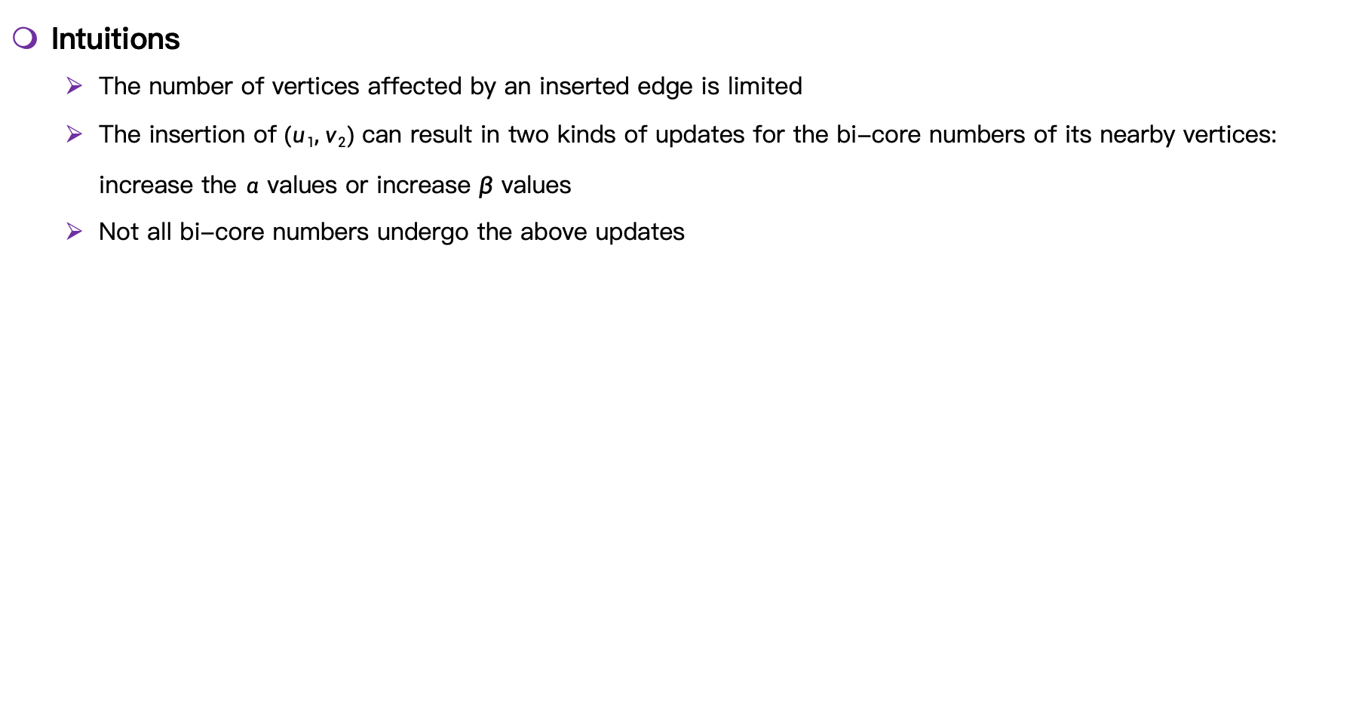
Our approach: edge insertion
Intuitions
The number of vertices affected by an inserted edge is limited
The insertion of$(u1, v2)$can result in two kinds of updates for the bi-core numbers of its nearby vertices: increase the $α$ values or increase $β$ values
Not all bi-core numbers undergo the above updates

Slide 8

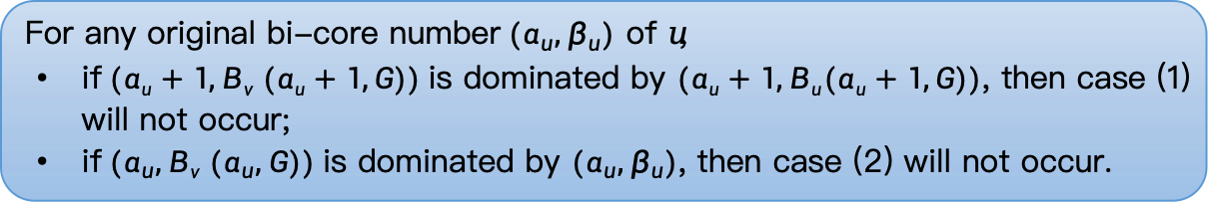
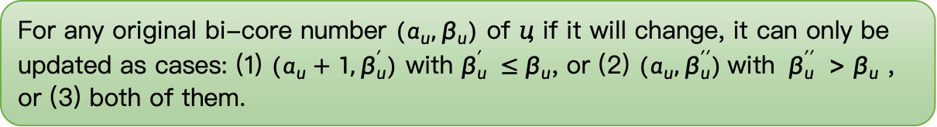
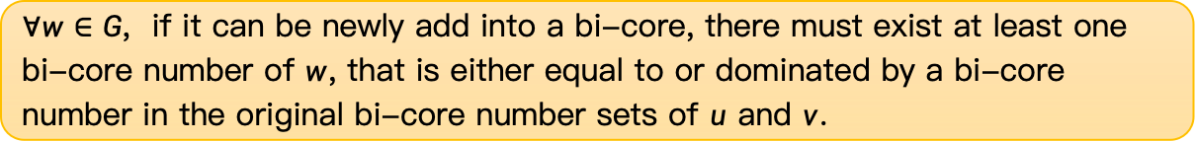
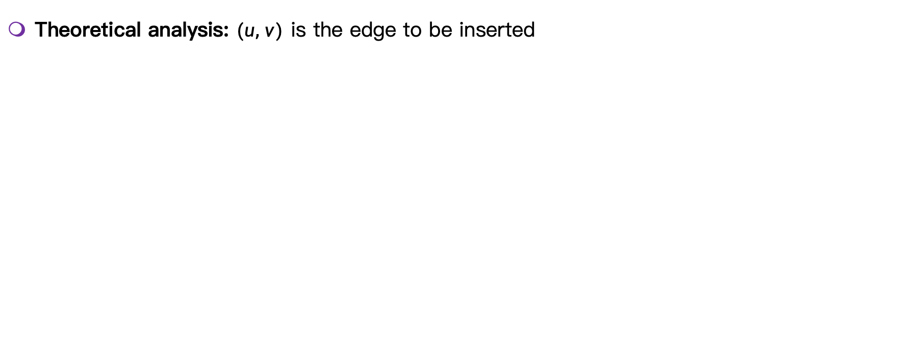
Our approach: edge insertion
Theoretical analysis: $(u, v)$ is the edge to be inserted
$∀w∈G$, if it can be newly add into a bi-core, there must exist at least one bi-core number of $w$, that is either equal to or dominated by a bi-core number in the original bi-core number sets of $u$ and $v$.
For any original bi-core number $(α_{u}, β_{u})$ of 𝑢, if it will change, it can only be updated as cases: (1) $(α_{u}+1, β_{u}^{′})$ with $β_{u}^{′} ≤β_{u}$, or (2) $(α_{u}, β_{u}^{′′})$with $β_{u}^{′′} >β_{u}$ , or (3) both of them.
They apply to the bi-core numbers of $v$, by swapping 𝑢 and $α$ with $v$ and $β$ respectively
For any original bi-core number$(α_{u}, β_{u})$ of 𝑢,
if$(αu+1, Bv (αu+1,G))$is dominated by $(αu+1, Bu(αu+1,G))$, then case (1) will not occur;
if$(α_{u}, Bv (α_{u}, G))$is dominated by $(α_{u}, β_{u})$, then case (2) will not occur.
e.g., $Bu_{1}(1,G)=3, Bu_{1}(2,G)=2$, and $Bu_{1}(3,G)=0$
Notes:
Based on the intuitions, we do theoretical analysis. Suppose (u, v) is the inserted edge.
The first lemma shows using bi-core number to determine wether an vertex can be updated. And we find that we only need to analyze the bi-cores corresponding to the bi-core numbers of u and v.
The shows the scope of the update, then, the second lemma shows the direction of the updates. Here are three cases: alpha increase, beta increase or both of them. Note that both of them means that through alpha increase and beta increase, a bi-core number is updated to two different c-pairs, instead of one new c-pair.
After we analyze the update cases, then the third lemma can be used to prune each case.
This two lemma shows the conditions on u’s bi-core numbers, they can also be applied to the bi-core numbers of v. The details will not be introduced here, they can be find in the paper with some examples.

Slide 9
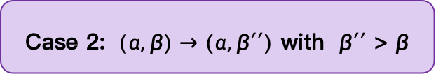
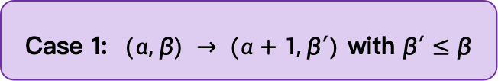
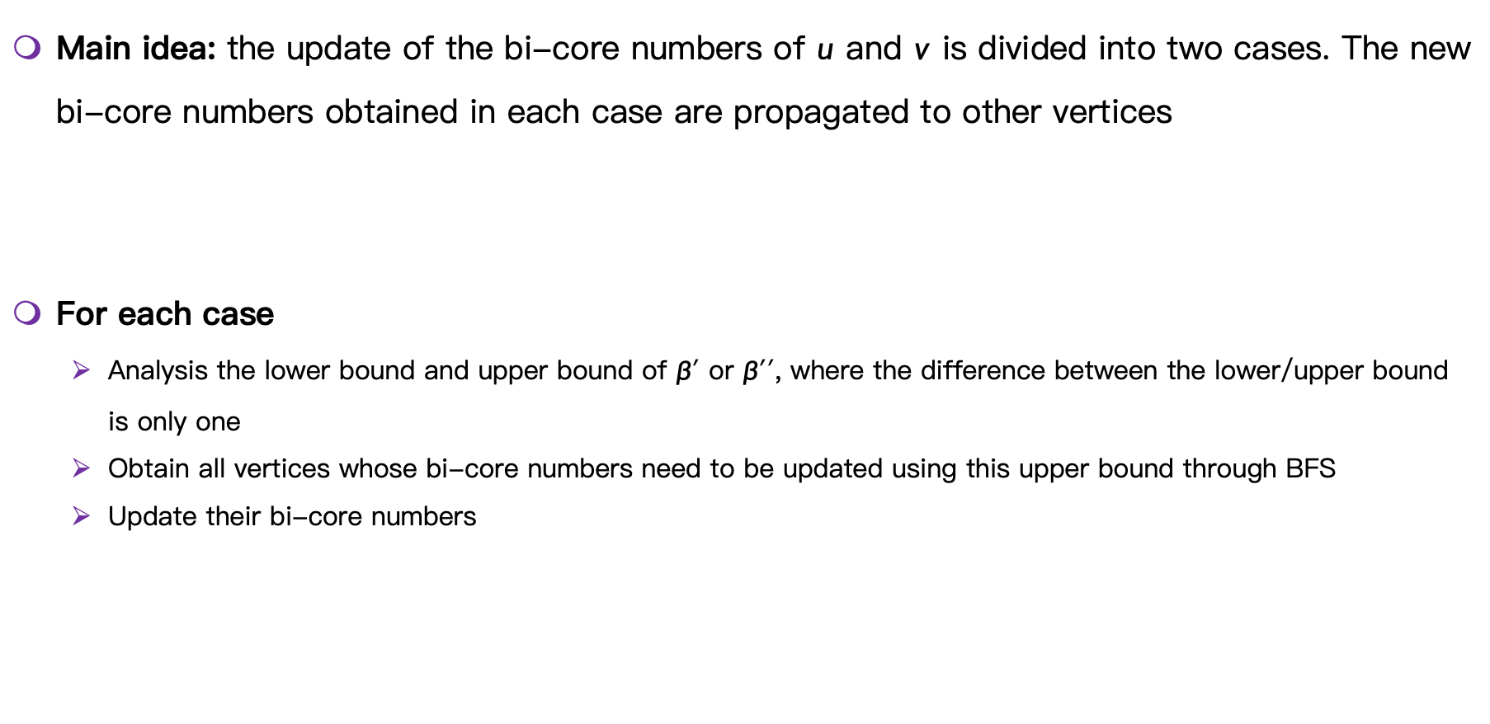
Our approach: edge insertion
Main idea: the update of the bi-core numbers of $u$ and $v$ is divided into two cases. The new bi-core numbers obtained in each case are propagated to other vertices
For each case
Analysis the lower bound and upper bound of $β′$ or $β′′$, where the difference between the lower/upper bound is only one
Obtain all vertices whose bi-core numbers need to be updated using this upper bound through BFS
Update their bi-core numbers
Case 1: $(α, β) → (α+1, β′)$ with $β′≤β$
Case 2: $(α, β)→(α, β′′)$ with $β′′>β$

Slide 10
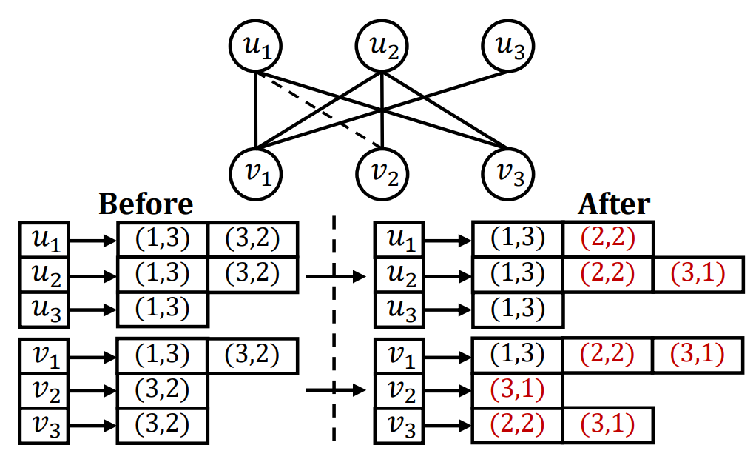
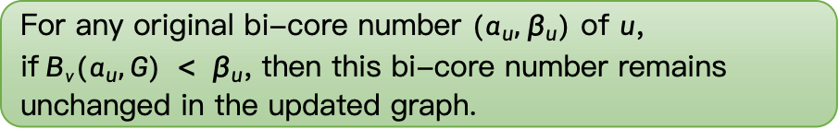
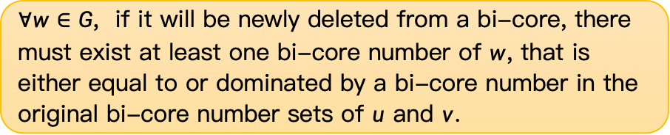
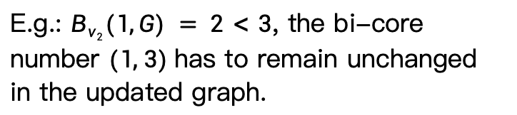

Our approach: edge deletion
Theoretical analysis: $(u, v)$ is the edge to be deleted
$∀w∈G$, if it will be newly deleted from a bi-core, there must exist at least one bi-core number of $w$, that is either equal to or dominated by a bi-core number in the original bi-core number sets of $u$ and $v$.
For any original bi-core number $(α_{u}, β_{u})$ of $u$, if$Bv(α_{u},G) < β_{u}$, then this bi-core number remains unchanged in the updated graph.
E.g.: $Bv_{2}(1,G) = 2<3$, the bi-core number $(1, 3)$has to remain unchanged in the updated graph.
Notes:
The edge deletion process is similar to the edge insertion process. Here are some theoretical analysis.
The first one is also using bi-core number to determine wether an vertex can be updated. And we find that we only need to analyze the bi-cores corresponding to the bi-core numbers of u and v.
For the second one, we prune the update scope further. This variable indicates that, for the vertex v, if we fix alpha equal to alpha_u, then v can be contained in many bi-cores, this variable is the maximum value among all the beta value.
Here is an example...
So, we only need to analyze a part of the bi-core numbers of u and v.

Slide 11

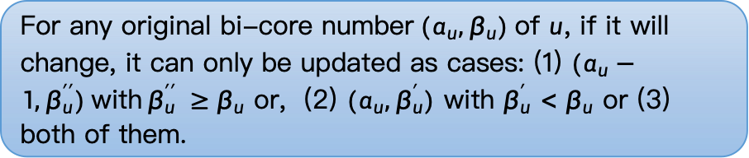
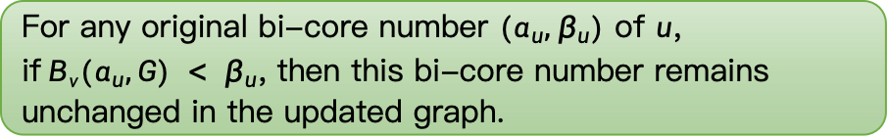


Our approach: edge deletion
Theoretical analysis: $(u, v)$ is the edge to be deleted
$∀w∈G$, if it will be newly deleted from a bi-core, there must exist at least one bi-core number of $w$, that is either equal to or dominated by a bi-core number in the original bi-core number sets of $u$ and $v$.
For any original bi-core number $(α_{u}, β_{u})$ of $u$, if$Bv(α_{u},G) < β_{u}$, then this bi-core number remains unchanged in the updated graph.
They apply to the bi-core numbers of $v$, by swapping 𝑢 and $α$ with $v$ and $β$ respectively.
For any original bi-core number$(α_{u}, β_{u})$of $u$, if it will change, it can only be updated as cases: (1) $(α_{u}−1, β_{u}^{′′})$with$β_{u}^{′′} ≥β_{u}$ or, (2) $(α_{u}, β_{u}^{′})$ with $β_{u}^{′}<β_{u}$ or (3) both of them.

Slide 12
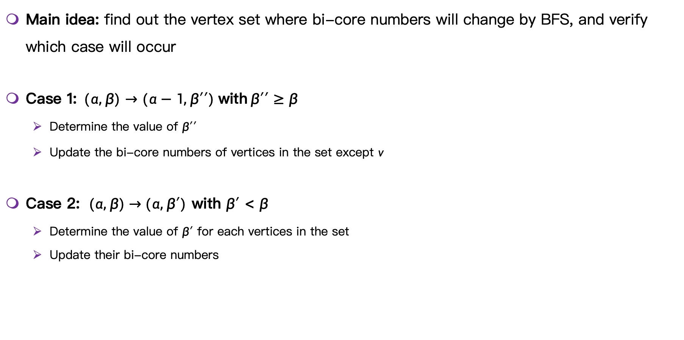
Our approach: edge deletion
Main idea: find out the vertex set where bi-core numbers will change by BFS, and verify which case will occur
Case 1:$(α, β)→(α−1, β′′)$with$β′′≥β$
Determine the value of $β′′$
Update the bi-core numbers of vertices in the set except $v$
Case 2: (𝛼, 𝛽) → (𝛼, $β′$) with $β′<β$
Determine the value of $β′$ for each vertices in the set
Update their bi-core numbers

Slide 13
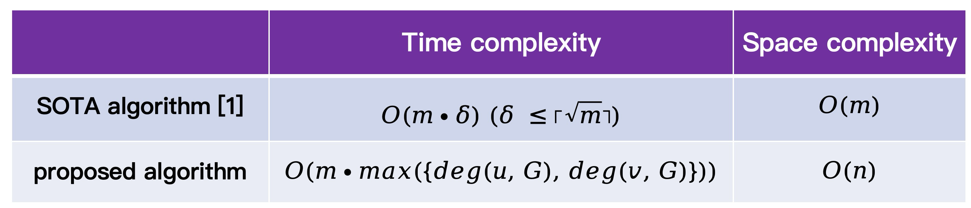
Complexity analysis: edge insertion and deletion
[1] Boge Liu, Long Yuan, Xuemin Lin, Lu Qin, Wenjie Zhang, Jingren Zhou: Efficient (α, β)-core computation in bipartite graphs. VLDB J. 29(5): 1075-1099 (2020)

Slide 14
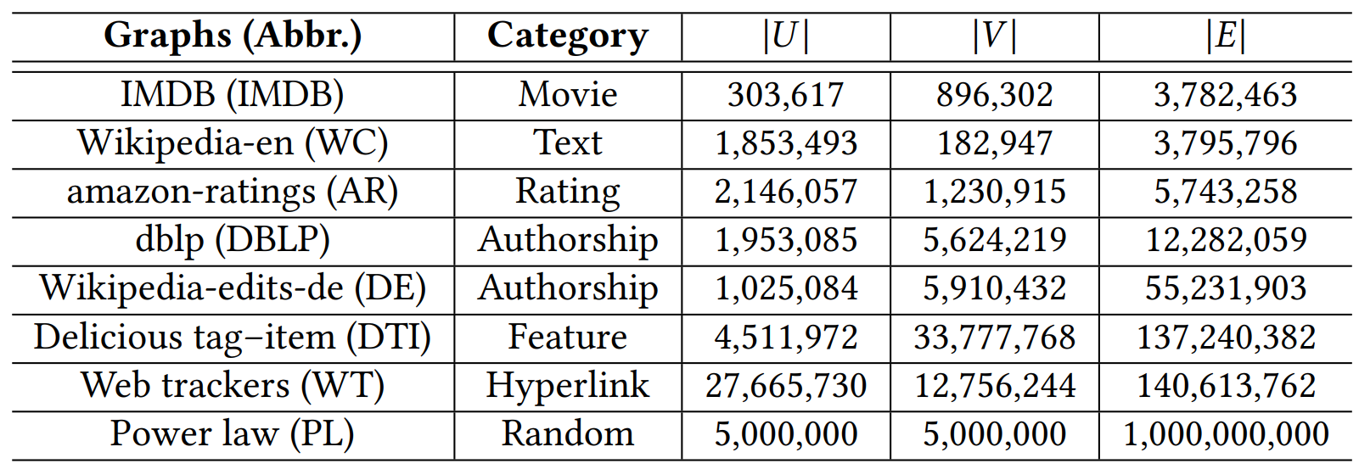

Experiment: setup
Datasets
We randomly select $r∈\{5000, 10000, 15000, 20000, 25000\}$ edges to simulate the edge insertion and edge deletion process
Linux with an Intel Xeon 2.40GHz CPU and 128GB RAM, C++ -O3

Slide 15
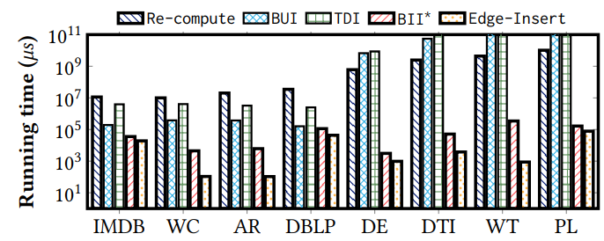
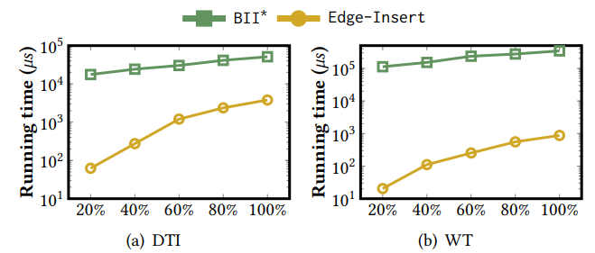
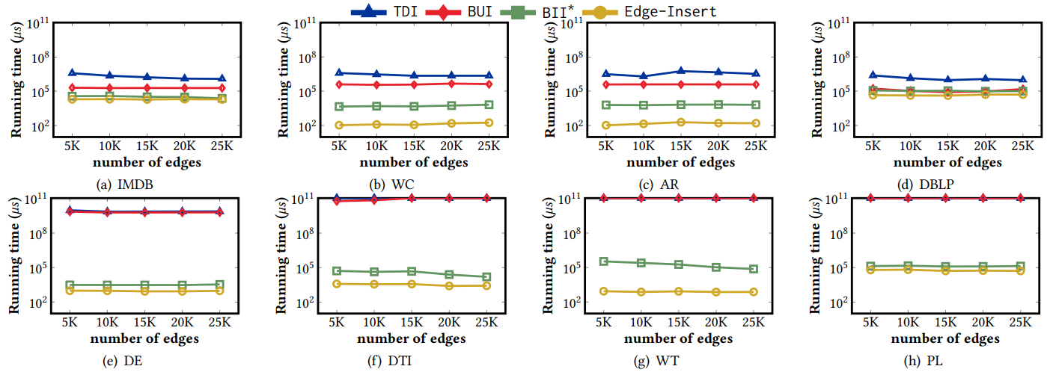
Experiment: edge insertion
Algorithm: (1) Re-compute[1]; (2) TDI[2]; (3) BUI[2]; (4) BII*[1]; (5) Edge-Insert (our algorithm)
~400x
Efficiency of an edge insertion on all datasets
Scalability test for handling edge insertions
Effect of the number of inserted edges (average time per edge)
[1] Boge Liu, Long Yuan, Xuemin Lin, Lu Qin, Wenjie Zhang, and Jingren Zhou. 2020. Efficient (𝛼 , 𝛽 )-core computation in bipartite graphs. The VLDB Journal 29, 5 (2020), 1075–1099.
[2] Wen Bai, Yadi Chen, Di Wu, Zhichuan Huang, Yipeng Zhou, and Chuan Xu. 2022. Generalized core maintenance of dynamic bipartite graphs. DMKD 36, 1 (2022), 209–239

Slide 16
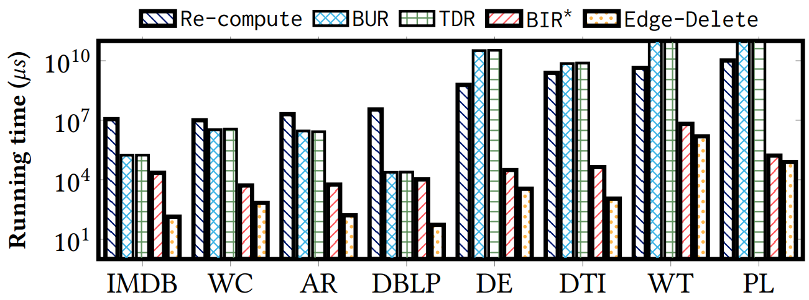
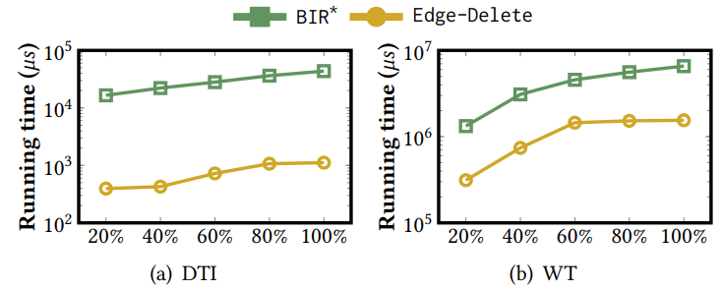
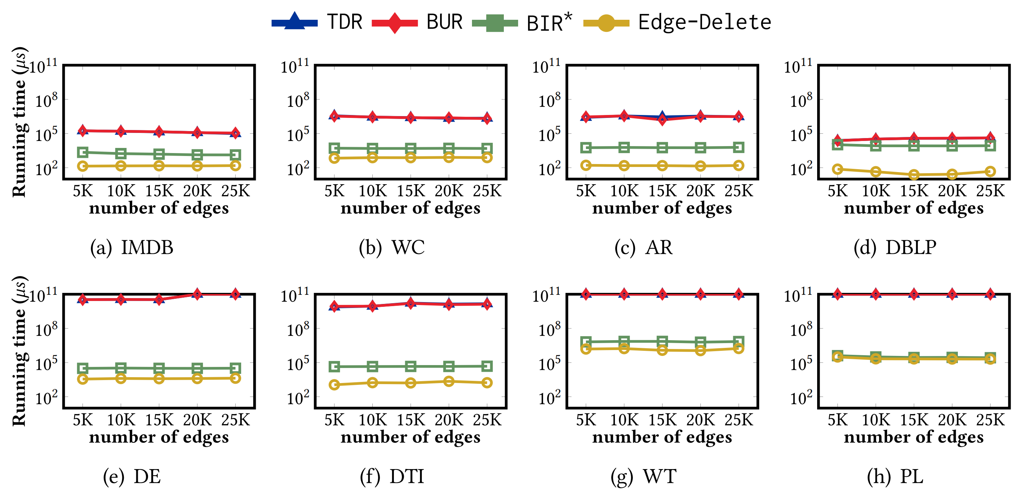
Experiment: edge deletion
Algorithm: (1) Re-compute[1]; (2) TDR[2]; (3) BUR[2]; (4) BIR*[1]; (5) Edge-Delete(our algorithm)
Efficiency of an edge deletion on all datasets
Scalability test for handling edge deletions
Effect of the number of deleted edges (average time per edge)
[1] Boge Liu, Long Yuan, Xuemin Lin, Lu Qin, Wenjie Zhang, and Jingren Zhou. 2020. Efficient (𝛼 , 𝛽 )-core computation in bipartite graphs. The VLDB Journal 29, 5 (2020), 1075–1099.
[2] Wen Bai, Yadi Chen, Di Wu, Zhichuan Huang, Yipeng Zhou, and Chuan Xu. 2022. Generalized core maintenance of dynamic bipartite graphs. DMKD 36, 1 (2022), 209–239

Slide 17
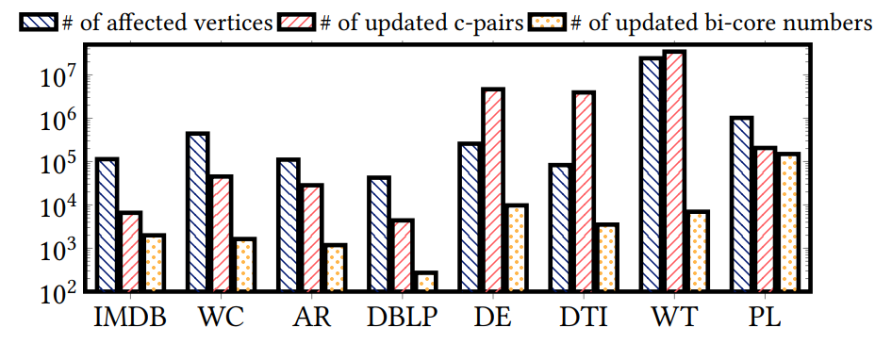
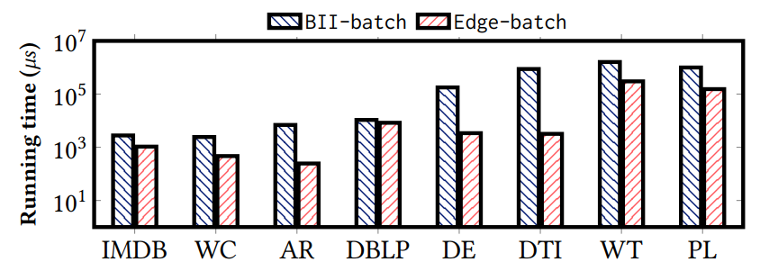
Experiment: other evaluations
The numbers of affected vertices, c-pairs, and bi-core numbers
Efficiency of batch update
BII-batch [1]
Edge-batch (our algorithm)
[1] Boge Liu, Long Yuan, Xuemin Lin, Lu Qin, Wenjie Zhang, and Jingren Zhou. 2020. Efficient (𝛼 , 𝛽 )-core computation in bipartite graphs. The VLDB Journal 29, 5 (2020), 1075–1099.

Slide 18
Thank You!
Email: qiaoyuanyang@link.cuhk.edu.cn

